Slide 1
EGWUEKWE NNEAMAKA PRECIOUS
INFORMATION SECURITY AND DIGITAL FORENSICS GRADUATE
COMPUTER SCIENTIST

Slide 2
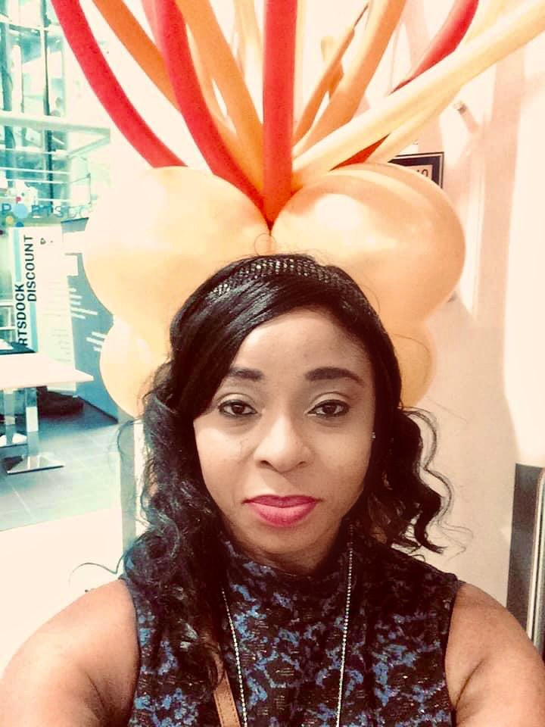
MSC INFORMATION SECURITY AND DIGITAL FORENSICS @UEL
MSC COMPUTER SCIENCE @UI
BSC COMPUTER SCIENCE @AAU

Slide 3
STUDENT AMBASSADDOR @ UEL STUDENT MENTOR @ LDE MEMBER STUDENT REPRESENTATIVE COUNCIL @UEL MEMBER ISACA @LONDON BRANCH MEMBER NIGERIA COMPUTER SOCIETY MEMBER COMPUTER PROFESSIONALS ASSOCIATION OF NIGERIA

Slide 4
ABOUT ME? My background is in computer science and information security, over the years I have helped organizations build and manage their website, I have taught computer sciences courses in schools as a lecturer, I have worked with my previous organization to get her NBTE accreditation for the computer science department , I have supervised student projects, I have have come up with ideas on how to better increase safety measures using captcha and also on intrusion detection for safety online. I have mentored students from the London college of design and engineering, helping them to find the right career path and also worked as a student ambassador , helping new students complete their enrolment and registration and getting them settled into university life and study, I have also been a member of the student representative council of my university, acting as intermediary between the student's and school management, working at improving the relationships within the school community.

Slide 5
My strength is my ability to give my very best in any thing I do. What I am looking for is a company that I could add value to, that I could give my energy and time into making something more positive which is aimed at moving the company forward. Is this what Glasswall is looking for?

Slide 6
I am enthusiastic a hardworker committed to what I do loves reading and never stop thriving to make progress.

